Slide 1

Enhancing a Backlit Portrait Photograph
DSA0205-Computer Vision with Open CV
Guided By
Dr. Narenthira Kumar A
Name: A. Yaswanth
Reg.No: 192324179

Slide 2
Abstract
Backlit portrait photographs often suffer from poor visibility because the light source is positioned behind the subject, causing the face to appear dark while the background appears overly bright. This project proposes an automated image enhancement system to improve the quality of backlit portrait images using digital image processing techniques. The system performs image preprocessing, analyzes lighting conditions and shadow regions, and applies enhancement methods such as Contrast Limited Adaptive Histogram Equalization (CLAHE), Gamma Correction, White Balance, Contrast Enhancement, and Brightness Adjustment to restore facial details while preserving natural colors and background quality. The enhanced image is evaluated using image quality metrics such as PSNR and SSIM to measure the effectiveness of the enhancement. The proposed system, implemented using Python and OpenCV, provides an efficient solution for producing clear, balanced, and visually appealing portrait photographs, making it suitable for applications in mobile photography, photo editing, surveillance, and digital imaging.

Slide 3
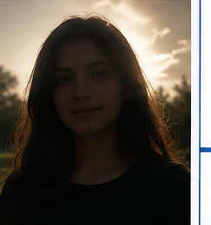



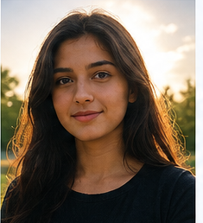













ENHANCING A BACKLIT PORTRAIT PHOTOGRAPH
INPUT IMAGE
1. IMAGE PREPROCESSING
2. BACKLIGHT ANALYSIS
3. IMAGE ENHANCEMENT
4. OUTPUT IMAGE
Backlit Portrait
Image Acquisition (OpenCV)
Face Detection
CLAHE (Contrast Enhancement)
Enhanced Portrait
Resize
Shadow Detection (Dark Region Analysis)
γ
Gamma Correction (Brightness Adjustment)
White Balance (Color Correction)
Color Space Conversion (BGR to RGB)
Brightness Analysis (Luminance Estimation)
Contrast Enhancement (Improve Visibility)
Source
Results
Camera
Noise Reduction (Gaussian Blur)
Illumination Estimation (Global & Local)
Face Clearly Visible
Tone Mapping (Preserve Background)
Reduced Shadows
Image File
Balanced Brightness
Histogram Analysis
Foreground–Background Segmentation
Brightness Adjustment (Face Illumination)
Natural Skin Tone
Better Contrast
High Quality Image
5. QUALITY EVALUATION
Brightness
Measurement
Contrast
Measurement
Sharpness
Check
PSNR
SSIM
Visual
Comparison
SYSTEM OUTPUT (ENHANCED PORTRAIT QUALITY)
Clear Facial
Details
Reduced
Shadows
Natural
Colors
Better
Contrast
Balanced
Illumination
High Quality
Image

Slide 4
Thank you

